Slide 1
Introduction to Linux Shell Scripting

Slide 2
Outline
Terminologies
Applications
Setup
Features
Redirection
Pipes
Filters
Basic commands
Examples
Short exercises

Slide 3
Terminologies

Slide 4
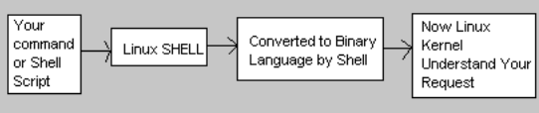
What is a Unix / Linux Shell?
It is an interface to Linux O/S.
It is the layer between the user and the kernel.
It is a program that accepts commands in English and translates it to binary language.
It is a command-line interpreter.
The most popular type of shells used in Linux are BASH, CSH and KSH.
This is the standard operation of a shell:

Slide 5
Types of shell
BASH
Bourne-Again Shell
The most common shell used in Linux.
Freeware
CSH
C Shell
Similar syntax and usage to C.
KSH
Korn Shell
Successor to BASH
Additional new features and improvement of C Shell.

Slide 6
What is a Kernel?
It is the core layer that manages the resources of Linux O/S.
I/O
Memory
Processes
Devices
Files
It is also a program that facilitates the interactions between hardware and software components.

Slide 7
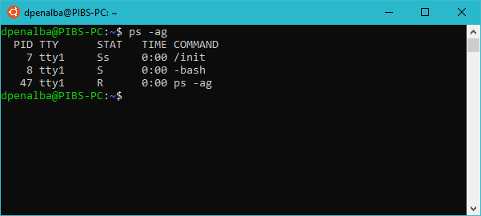
What is a Process?
It is a program that performs a job based on the commands given by the user.
It is represented by a process-id or PID.
E.g. The command ps-ag shows all the running processes with unique PIDs.

Slide 8
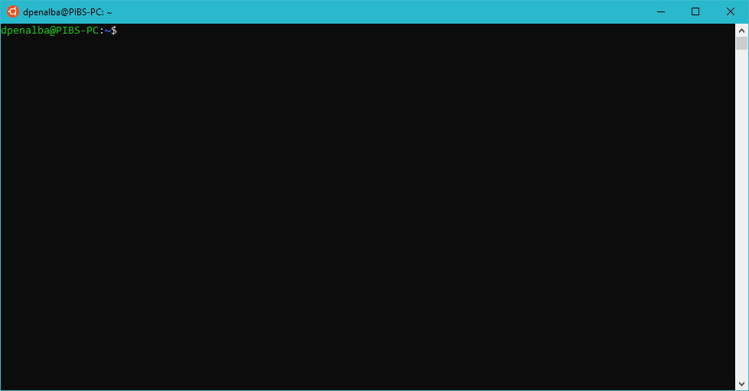
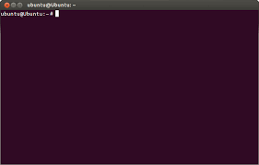

What is a Terminal?
A terminal in Linux O/S is a GUI application that visually represents the shell for the user to enter commands.

Slide 9
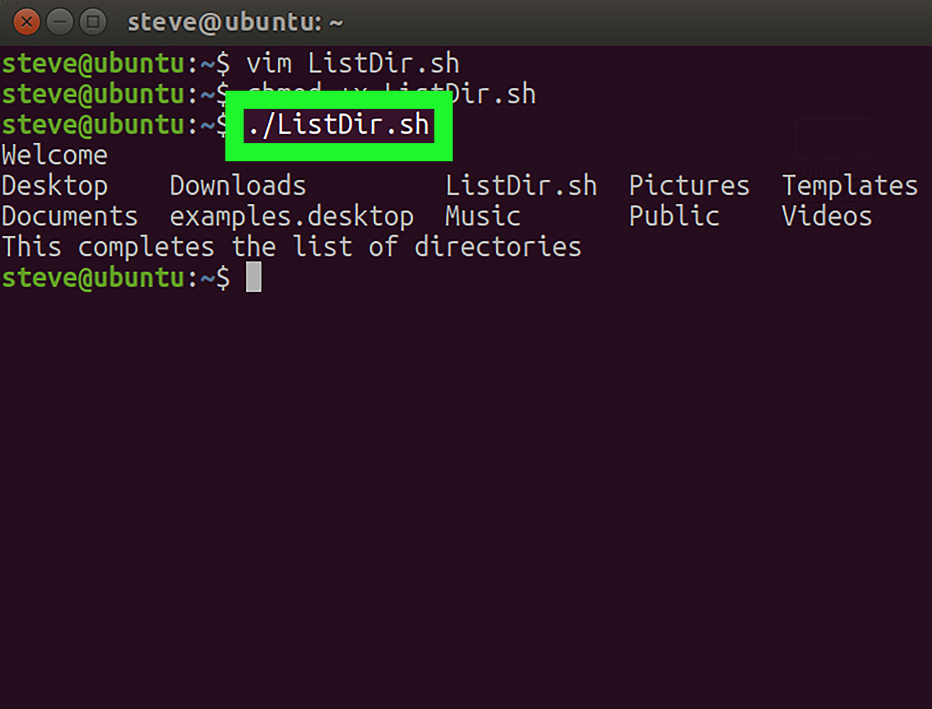

What is a Shell Script?
It is a file containing list of commands listed in order of execution.
It carries out the commands when read, similar to executing the commands using the command line.
It is similar to a batch file in MS-DOS.
The commonly used file extension for a shell script is .sh
Running a .sh file:

Slide 10



Applications of shell scripting
Here are some systems and processes that use shell scripting to automate tasks:
Database backup
Administrative tasks
Email and network services alert systems
Linux system monitoring
User account lock safety

Slide 11

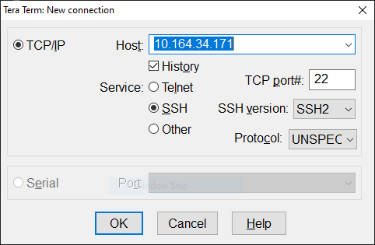
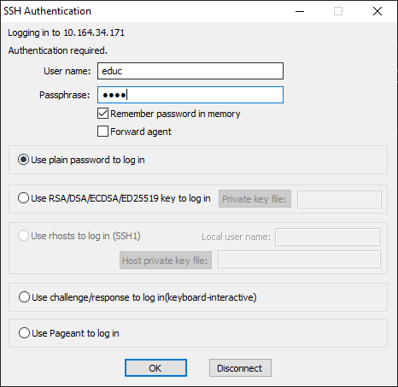
Setup
Open Tera Term on your machine.
Input the connection details:
Input credentials
User name: educ
Passphrase: educ

Slide 12
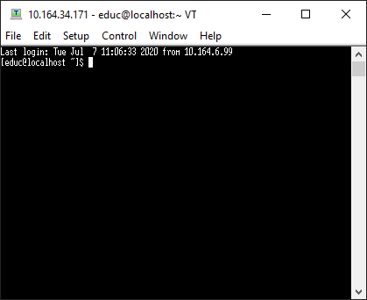
Setup

Slide 13
Features

Slide 14
Redirection
Linux commands can read input from file or send output to file. The commands use redirection operators >, >>, and <.
> - send/write output to file. Example: $ls > myFile.sh
>> - send/write output to END of file. Example: $date >> myFile.sh
< - take/read input from file. Example: $cat < myFile.sh
This will create a file named myFile.sh and will overwrite the file if it is existing.
This will write date to the END of myFile.sh and will not overwrite it.
This will read the file.

Slide 15
Redirection
Also involves handling of data stream. File descriptors for stdin, stdout, stderr are represented as integer values.
File | File Descriptor
Standard Input stdin | 0
Standard Output stdout | 1
Standard Error stderr | 2

Slide 16
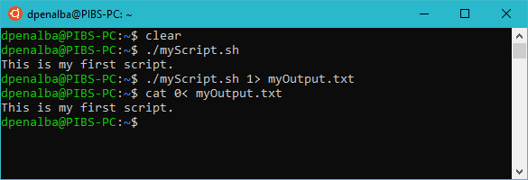
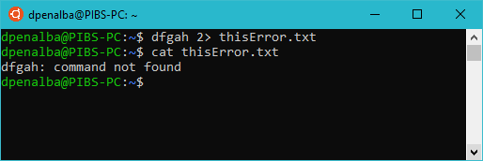
Redirection
Use 1 to redirect output
Redirecting input using 0 is unnecessary at most cases. We can also represent the line of command the same as:
cat < myOutput.txt
2 redirects error log. By default the error is still redirected to File Descriptor 1 so it can be displayed.

Slide 17
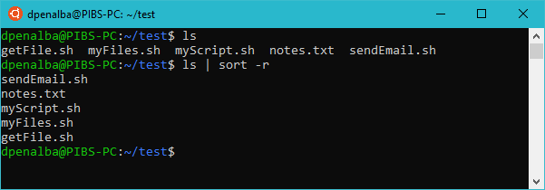
Pipes
Connects the output of one command to the input of the next command. It can be used multiple times. The command use pipe operator |
Example:
The output of ls which are the list of files will be the input to the next command which is sort -r. It will sort the files in reverse alphabetical order.

Slide 18
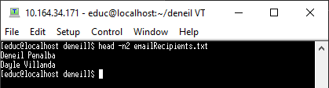
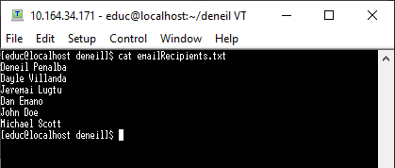
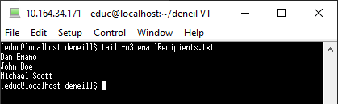
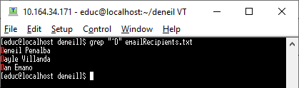
Filters
Accepts its input from the standard input, process it, and produces its output on the standard output.
Common filter commands are head and tail.
Example:
-n2 (first two lines)
-n2 (last 3 lines)
emailRecipients.txt contains a list of names.
Filter names that starts with “D”.

Slide 19
Basic Commands

Slide 20
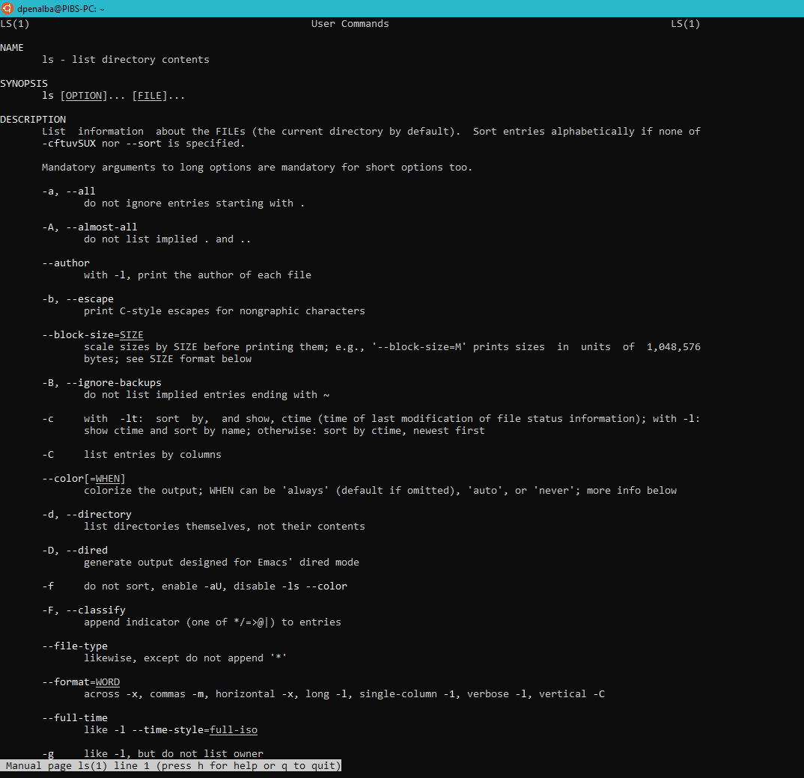
man
Example: man –a ls
Provides the manual of a specific command.
Usage: man [OPTION] ... [COMMAND] ...

Slide 21
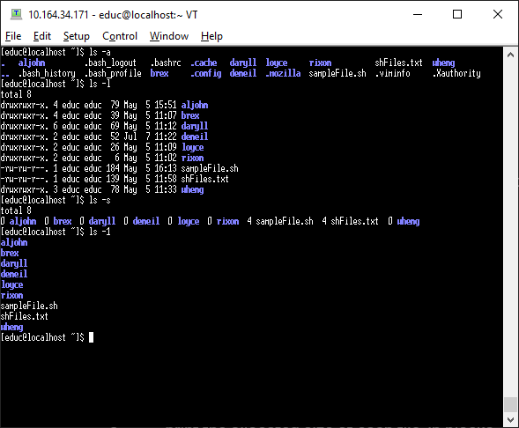
ls
List information about the FILEs (the current directory by default).
Usage: ls [OPTION]... [FILE]...
Options:
-a list all entries. (directories, files, etc.)
-l uses a long listing format.
-s print the allocated size of each file, in blocks.
-1 list one file per line.

Slide 22
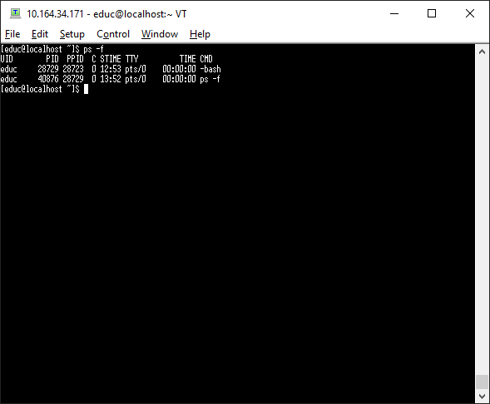
ps
Outputs processes information.
Usage: ps [OPTION]...
Options:
-A all processes.
r only running processes.
-p <PID> select by process id.
-f full-format including command lines.

Slide 23
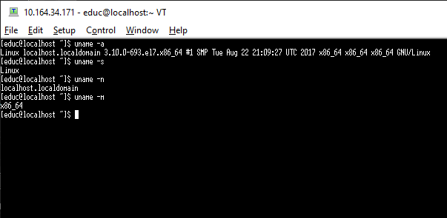
uname
Print certain system information.
Usage: uname [OPTION]...
Options:
-a print all information.
-s print the kernel name
-n print the network node hostname
-m print the machine hardware name

Slide 24
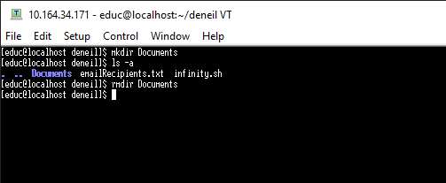
mkdir / rmdir
mkdir - Make a new directory.
rmdir - remove directory.
Usage: mkdir [OPTION]... DIRECTORY…
rmdir [OPTION]... DIRECTORY…

Slide 25
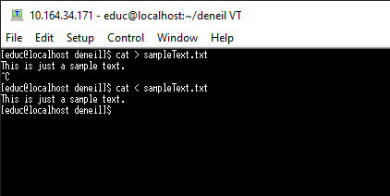
cat
Concatenate files to standard output.
Usage: cat [OPTION]... [FILE]...

Slide 26
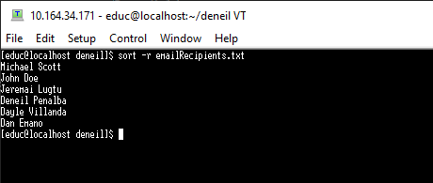
sort
Write sorted concatenation of files to standard output.
Usage: cat [OPTION]... [FILE]...
Options:
-r reverse result.
-f ignore case.

Slide 27
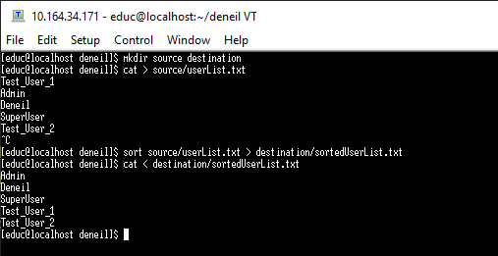
Exercise 1
Make two directories named source and destination.
In the source directory, make a text file named userList.txt containing at least 5 unique usernames.
3. Sort the usernames alphabetically and output the file named sortedUserList.txt to the destination directory.
Solution:

Slide 28
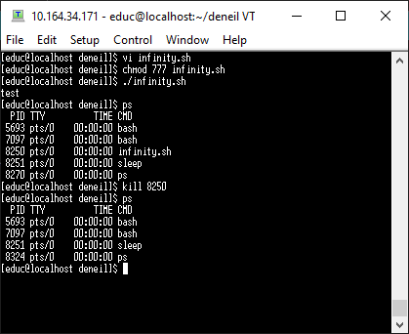
kill
send a signal to kill a process.
Usage: kill [options] <pid>
Options:
-9 force kill process.

Slide 29
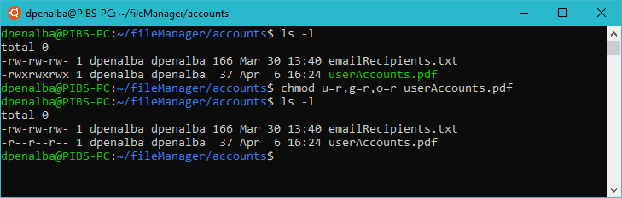
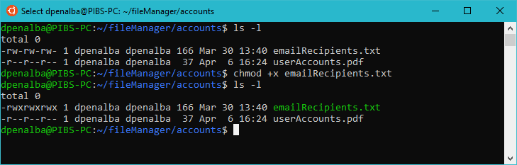
chmod
Change file permissions of a file.
Usage: chmod [OPTION]... MODE[,MODE]... FILE…
Options:
u= user
g= group
o= other
+-r / +-w / +-x read, write, execute.

Slide 30
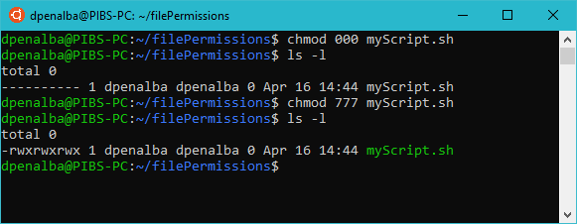
File permissions - READ, WRITE, EXECUTE
In using chmod, we can also represent each file permission to a corresponding number.
N | Description | ls | binary
0 | No permissions at all | --- | 000
1 | Only execute | --x | 001
2 | Only write | -w- | 010
3 | Write and execute | -wx | 011
4 | Only read | r-- | 100
5 | Read and execute | r-x | 101
6 | Read and write | rw- | 110
7 | Read, write, and execute | rwx | 111

Slide 31
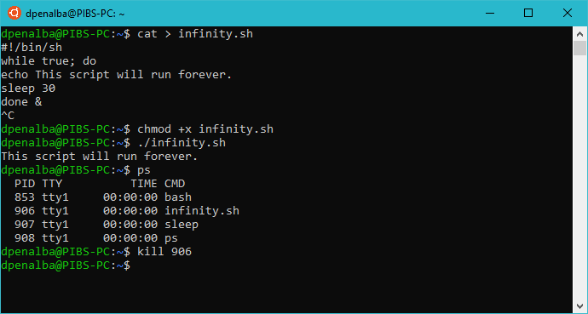
Exercise 2
Make a script file (.sh file extension) that will run significantly on a long period or an infinite loop. Make sure to change the file permission to executable.
Input the sample script below to the file:
#!/bin/sh
while true; do
echo This script will run forever.
sleep 30
done &
Execute and kill the process.
Solution:

Slide 32
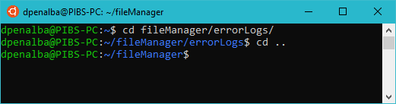
cd
Change the current directory to DIR. The default DIR is the value of the HOME shell variable.
Usage: cd [OPTION]... [LOCATION]...
Options:
.. return to previous upper directory.
[none] return to host location.

Slide 33
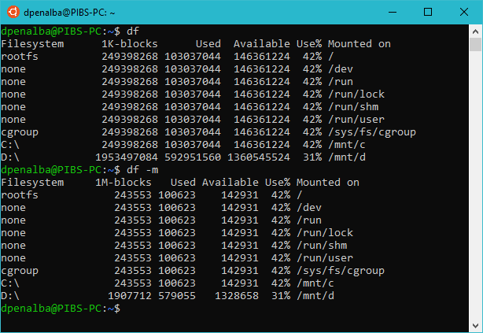
df
report file system disk space usage.
Usage: df [OPTION]... [FILE]...
Options:
-m display available space in megabytes.

Slide 34
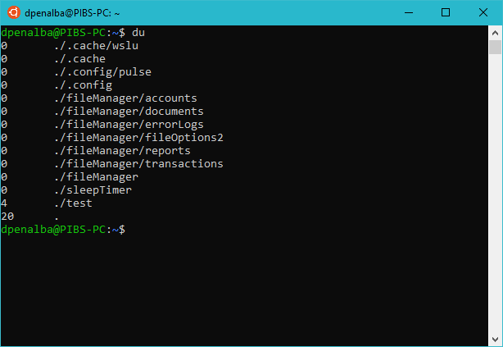
du
Summarize disk usage of the set of FILEs, recursively for directories.
Usage: du [OPTION]... [FILE]...

Slide 35
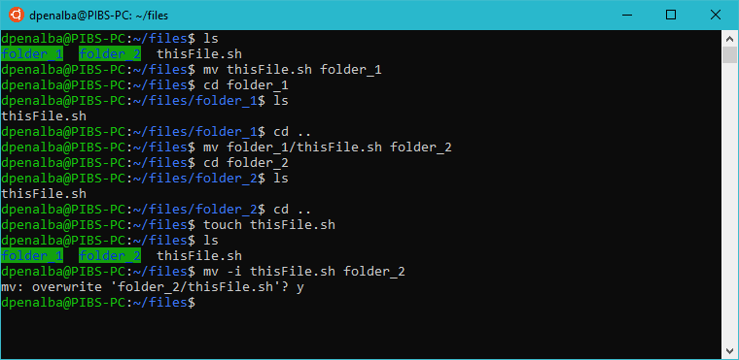
mv
Rename file or move source to directory.
Usage: mv [OPTION]... [-T] SOURCE DEST
or: mv [OPTION]... SOURCE... DIRECTORY
or: mv [OPTION]... -t DIRECTORY SOURCE...
Options:
-f overwriting will not require a prompt.
-i overwriting will require a prompt.

Slide 36
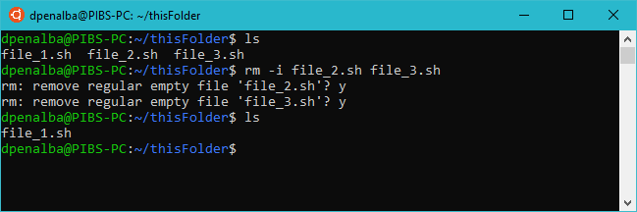
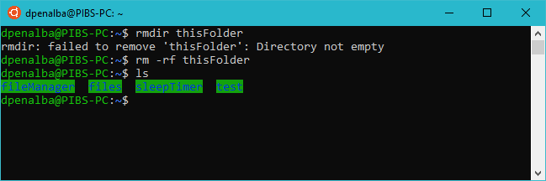
rm
Remove file.
Usage: rm [OPTION]... [FILE]...
Options:
-f force removal without prompts.
-I prompt before every removal.
-r remove contents recursively.

Slide 37
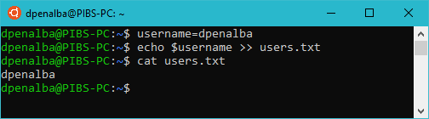
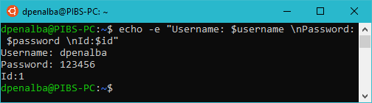
echo
Helps move data, usually text into a file.
Usage: echo [OPTION]... [STRING]... > / >> [FILE]...
Options:
-e interprets escape characters that are backslashed.
-n will not print the trailing newline.
Common string escape characters:
\b, \\, \n, \r, \t, \v

Slide 38
apt-get , apt-cache
Apt-get downloads and installs packages to the repository of the system. Must always use sudo command. Apt-cache is used to search for available package in the package.
Usage: sudo apt-get [OPTION]... [PACKAGE]...
apt-cache search [PACKAGE]...
Options:
install install a package.
update updates repository. Execute every after installation.
upgrade upgrades the system.
search search for the package

Slide 39
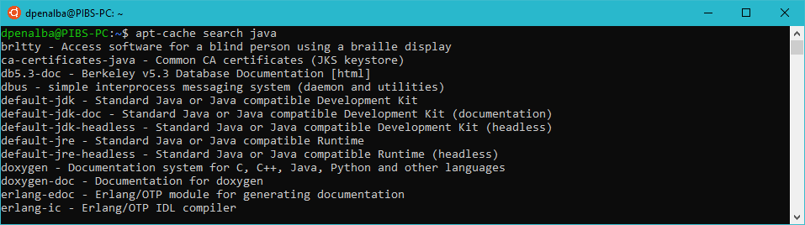
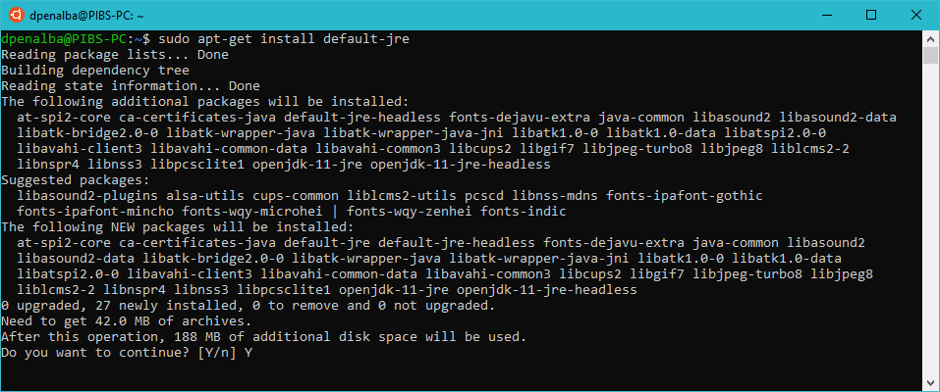
Search for any package. In this case, we are about to install jre.

Slide 40
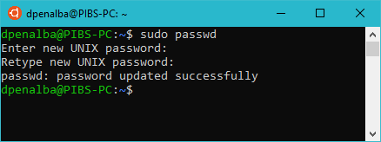
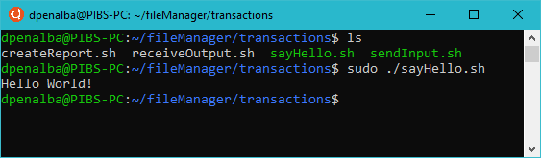
sudo
execute a command as a super user with administrative privileges.
Usage: sudo [COMMAND]...
Options:
-A use a helper program for password prompting.
-l list user's privileges or check a specific command.

Slide 41
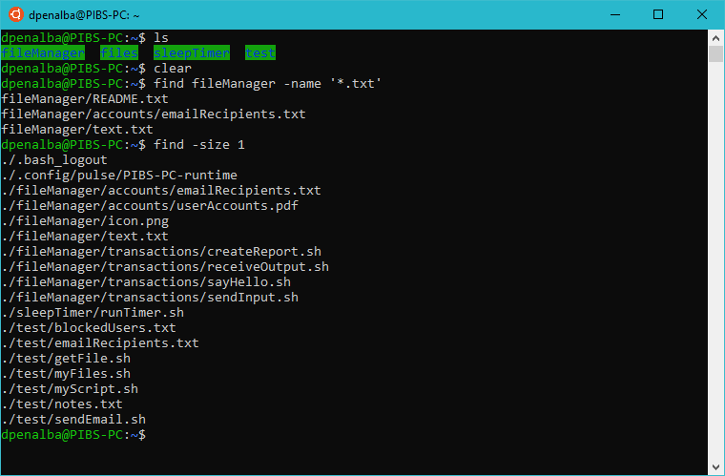
find
search for files in a directory hierarchy.
Usage: find [PATH]... [OPTION]... [EXPRESSION]...
Options:
-name find by case-sensitive filename.
-iname find by case-insensitive filename.
-size find by file size.

Slide 42
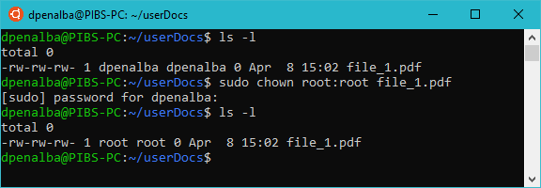
chown
Change the owner and/or group of each file or directory.
Usage: chown [OPTION]... [OWNER][:[GROUP]] FILE...
Notes:
Use $less /etc/passwd to list all available user info.
Use sudo in command to execute without restrictions.

Slide 43
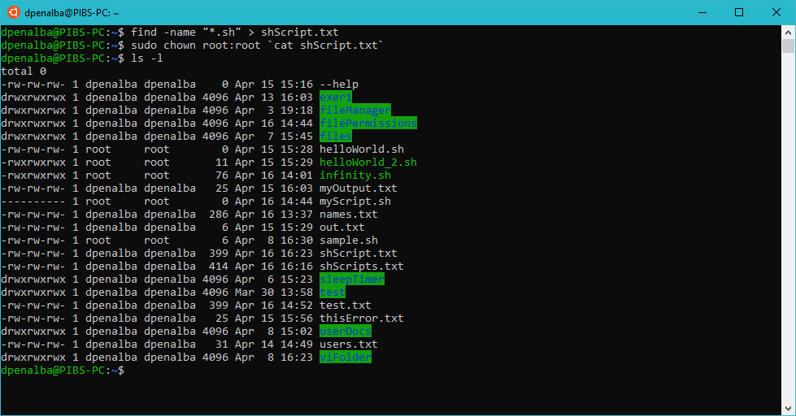
Exercise 3
Find all files with file extension .sh and store the output on a text file.
Change the ownership of the files to root owner and root group using the text file.
Tip: You can enclose a line of command using
`<command>` as a substitute input.
E.g. chown [OWNER]:[GROUP] `cat thisFile.txt`
Solution:

